Slide 1
Signature Service - Coding Challenge

Slide 2
Overview
A service to manage and utilize Signature devices.
Creation of Signature devices with ECC or RSA algorithms.
Signing of transaction data.
Listing of all created devices.

Slide 3
API Endpoints
Create Signature Device:
POST - /api/v0/device
Request: {"id": "device123", "algorithm": "ECC", "label": "My Device" }
Response :{ "device_id": "base64-encoded-signature", "label": "My Device" }
Sign Transaction:
POST - /api/v0/sign
Request: { "device_id": "base64-encoded-signature", "data": "some transaction data"}
Response : { "signature": "base64-encoded-signature", "signed_data": "1_some transaction data_base64(device_id)"}
List Devices:
GET - /api/v0/devices
Response :
[ { "id": "base64-encoded-signature",
"label": "My Device",
"algorithm": "ECC",
"signature_counter": 1 }]

Slide 4
API Endpoints
Sample :
curl -X POST "http://localhost:8080/api/v0/device" -H "Content-Type: application/json" -d "{\"id\": \"device123\", \"algorithm\": \"ECC\", \"label\": \"My Device\"}“
curl -X POST "http://localhost:8080/api/v0/sign" -H "Content-Type: application/json" -d "{\"device_Id\":
\"30e9f774-1826-46db-828c-2a1e90ad26f5\", \"data\": \"transaction data\"}"
curl -X GET "http://localhost:8080/api/v0/devices"

Slide 5
How to Run?
1. Setting Environment Variables:
PORT: Port number for the server (default is ‘:8080’).
STORAGE_TYPE: Type of storage to use (in-memory or db).
2. Running the Application:
go run main.go

Slide 6
Design
Design Patterns:
Factory Pattern: The storage package uses a factory design to switch between in-memory and db storage.
Middleware Pattern: Middleware functions are used to set CORS headers and handle preflight requests.
DTO (Data Transfer Object) Pattern: KeyDataPair and response structures encapsulate data for API responses.

Slide 7
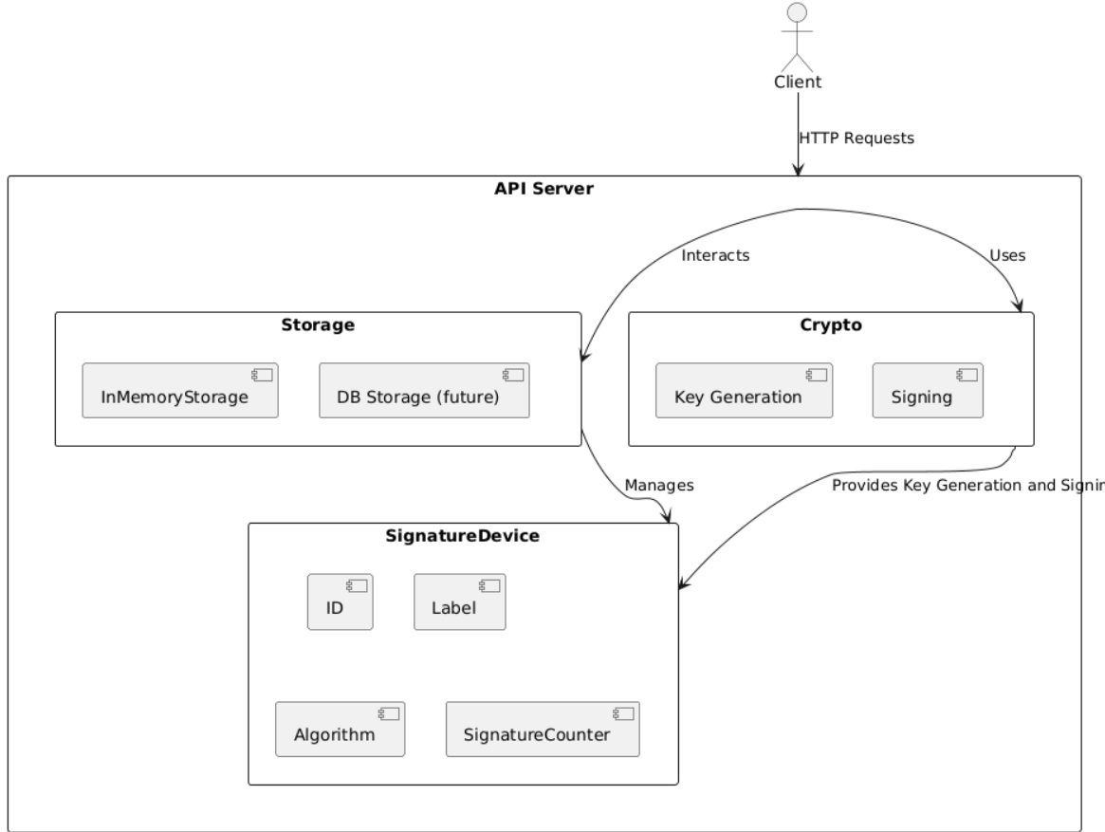
System Design

Slide 8
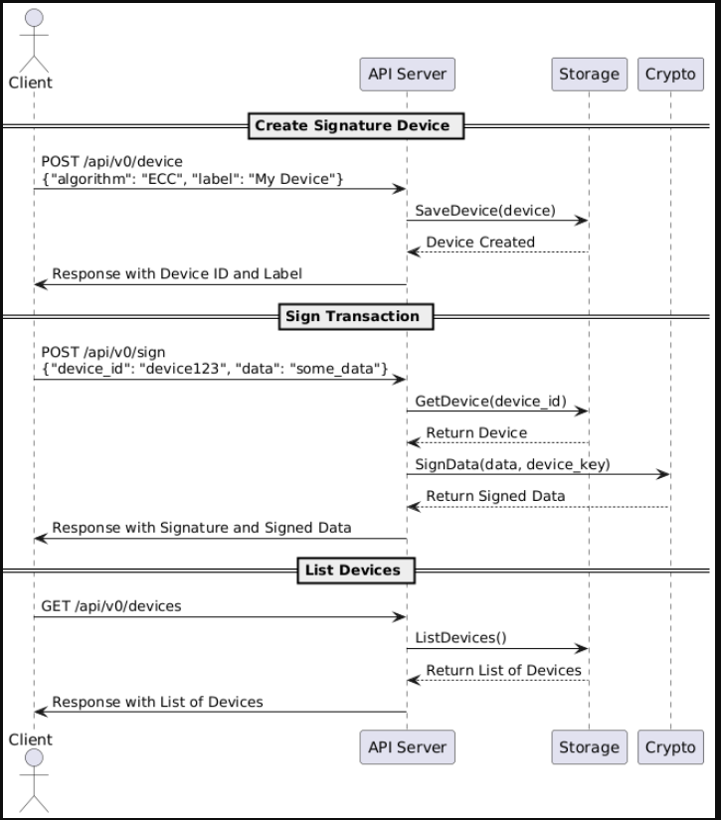
System Design

Slide 9
Testing
Unit Test:
server_test.go:
TestCreateDevice: To validate the /api/v0/device endpoint for creating signature devices(POST).
TestSignTransaction: To validate the /api/v0/sign endpoint for signing transactions (POST).
TestListDevices: To validate the /api/v0/devices endpoint for listing all devices (GET).
in_memory_test.go:
TestInMemoryStorage: Verify that a SignatureDevice can be correctly saved in the in-memory storage.

